Slide 1
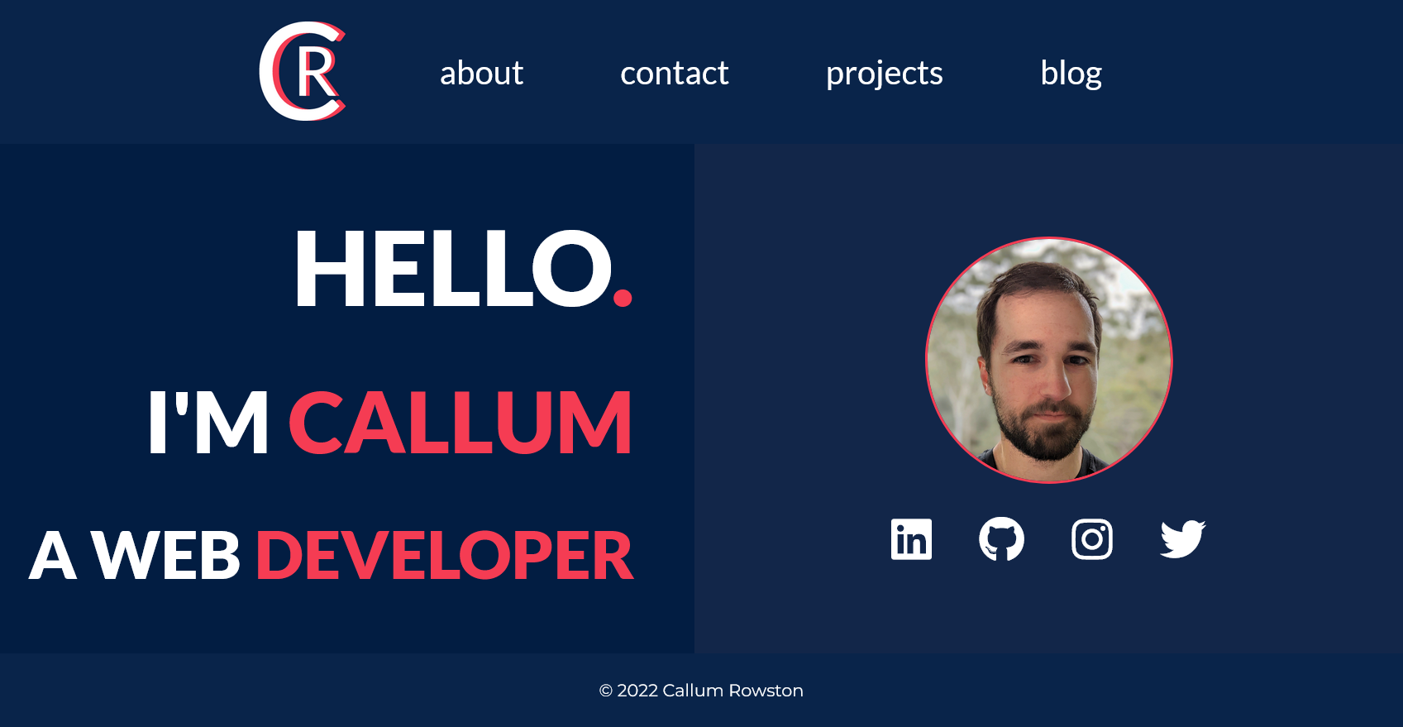
Callum Rowston Portfolio Website Presentation
Notes:
Hello Im Callum Rowston and this is my presentation of my website for the term1 portfolio assessment

Slide 2
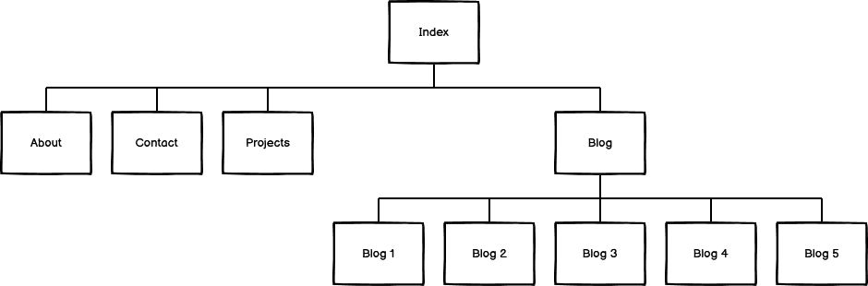
Sitemap
Notes:
Simple and logical layout make sit easy to navigate. Home page links out to 1 of 4 pages; about, contact, projects and blog. The blog page then links to 5 different full blog posts.

Slide 3


Components
Navigation Bar
Social Media Links
Introduction
About Information
Contact Information
Project Card
Blog Card
Blog Post
Footer
Navigation bar
Social Media Links
Notes:
Nav Bar – Used to move around the site. Contrasting colours make it engaging. Text size increases on hover. Current page is underlined.
Social Media links – To link to things like linked in and github so the user can connect with me through those services and see more about who I am. Icons change colour and jiggle on hover to make it engaging and obvious which account they are selecting.
Footer – Just a copyright notice.

Slide 4
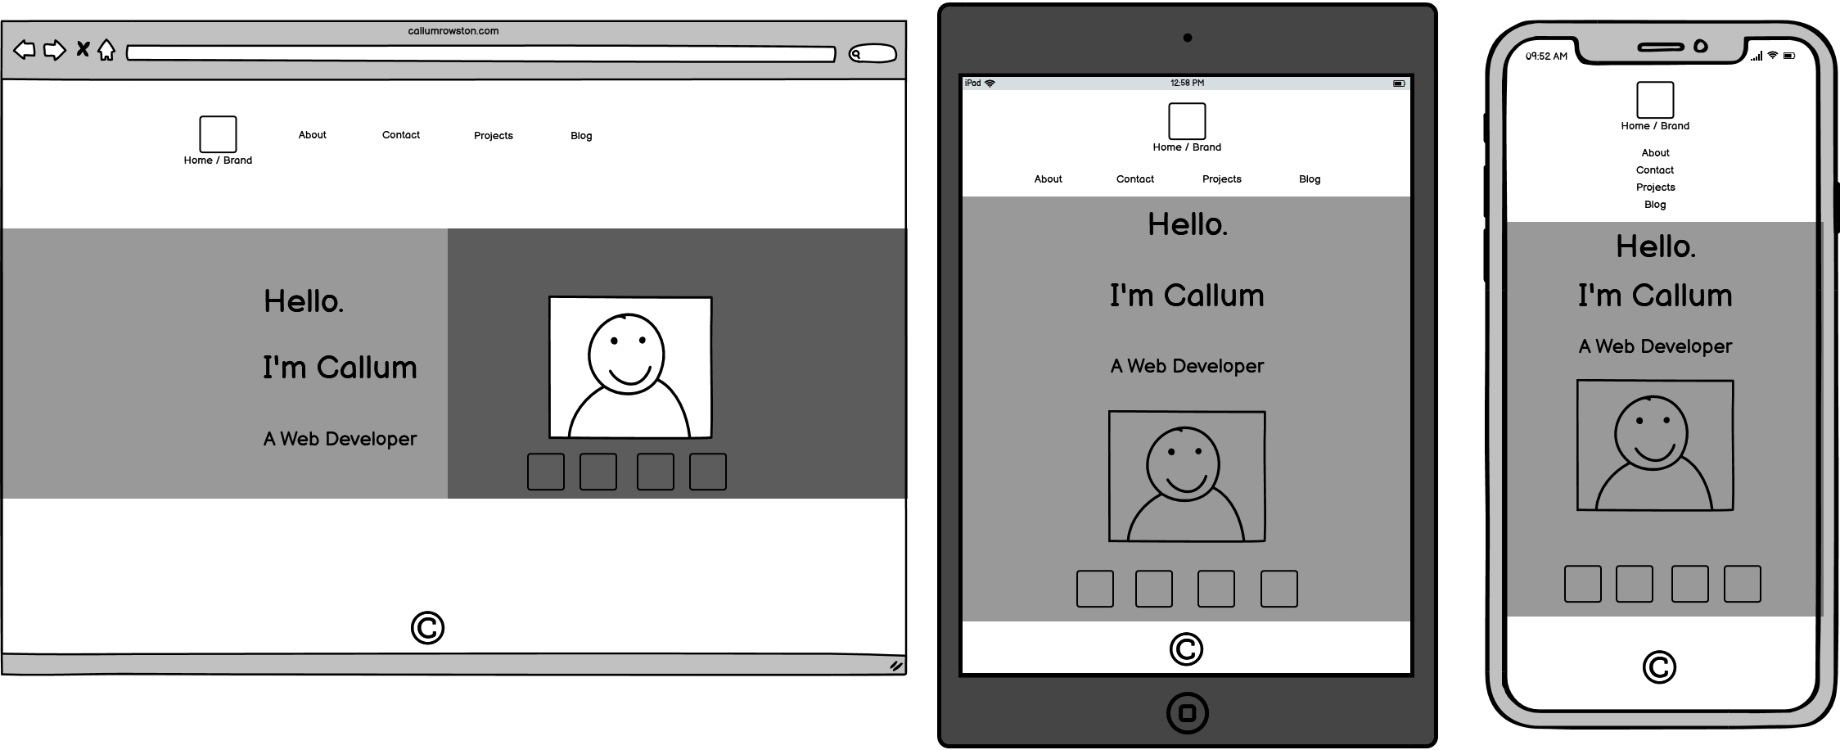
Index Page Wireframes
Notes:
I wanted the fundamental aesthetic of the site to be modern but simple to make it easy to use. In general the major elements of each page are in their own box and the way the boxes stack will change depending on screen size.
You can see the nav bar adjusts to screen size to it is easier to tap on each page link if you’re using tablet or phone. You’ll see this on every page.
Introduction – Simple message introducing myself and a profile photo. Quick links to social media if someone is just trying to connect quickly that way and doesn’t necessarily want to dig through the rest of my site to find that information which adds an element of ease of use.
Intro message shifts to the top on smaller screens

Slide 5
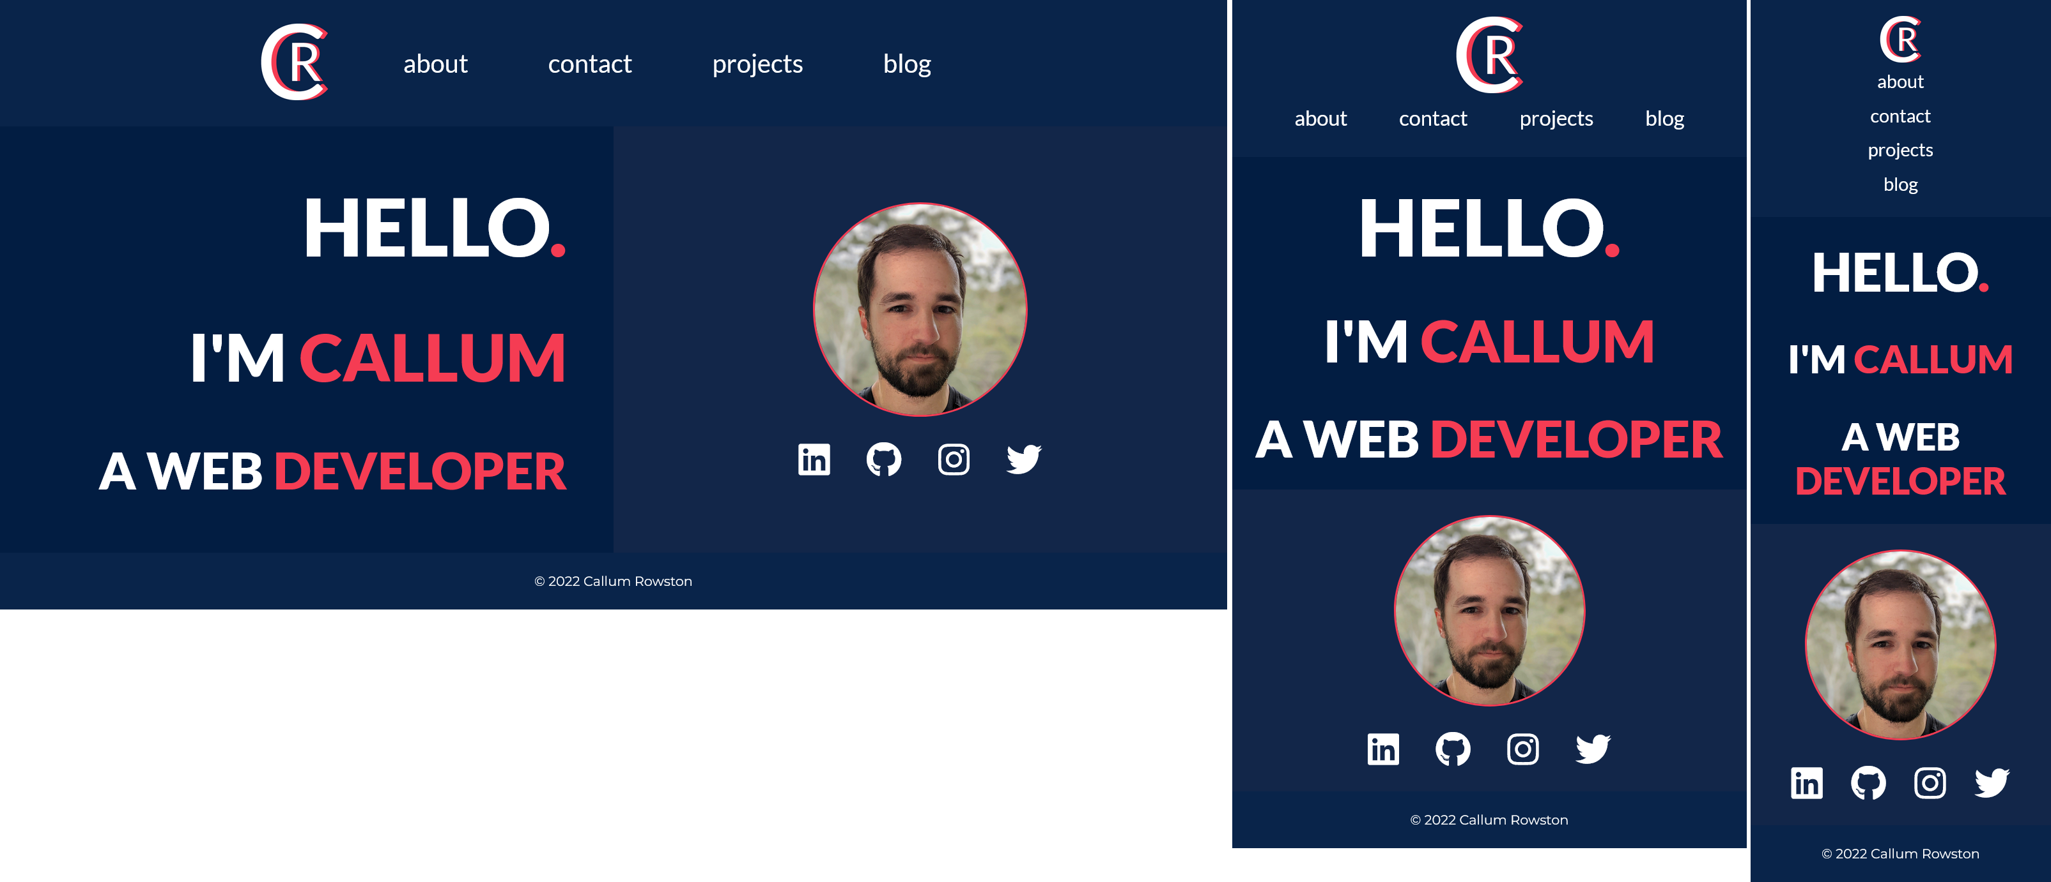
Index Page
Notes:
Colour is a big part of the design language of the site. I’ve used this bright salmon-pink and white colours to contrast against the dark background. This contrast makes the site
Easy to read, which also helps with accessibility
Important elements stand out
3) Helps convey information such as if your cursor is on an interactable link or what page of the site you’re on

Slide 6
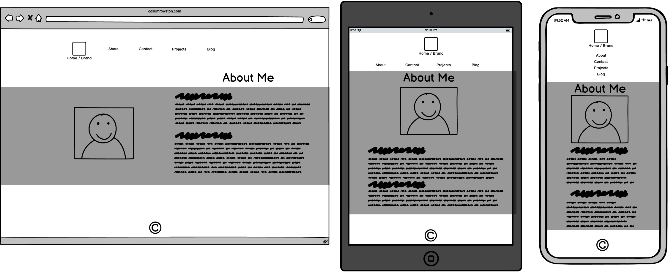
About Page - Wireframes
Notes:
Same idea as the index page, but instead of a introduction message I have more details about my background, work and study history and some of my personal interests

Slide 7
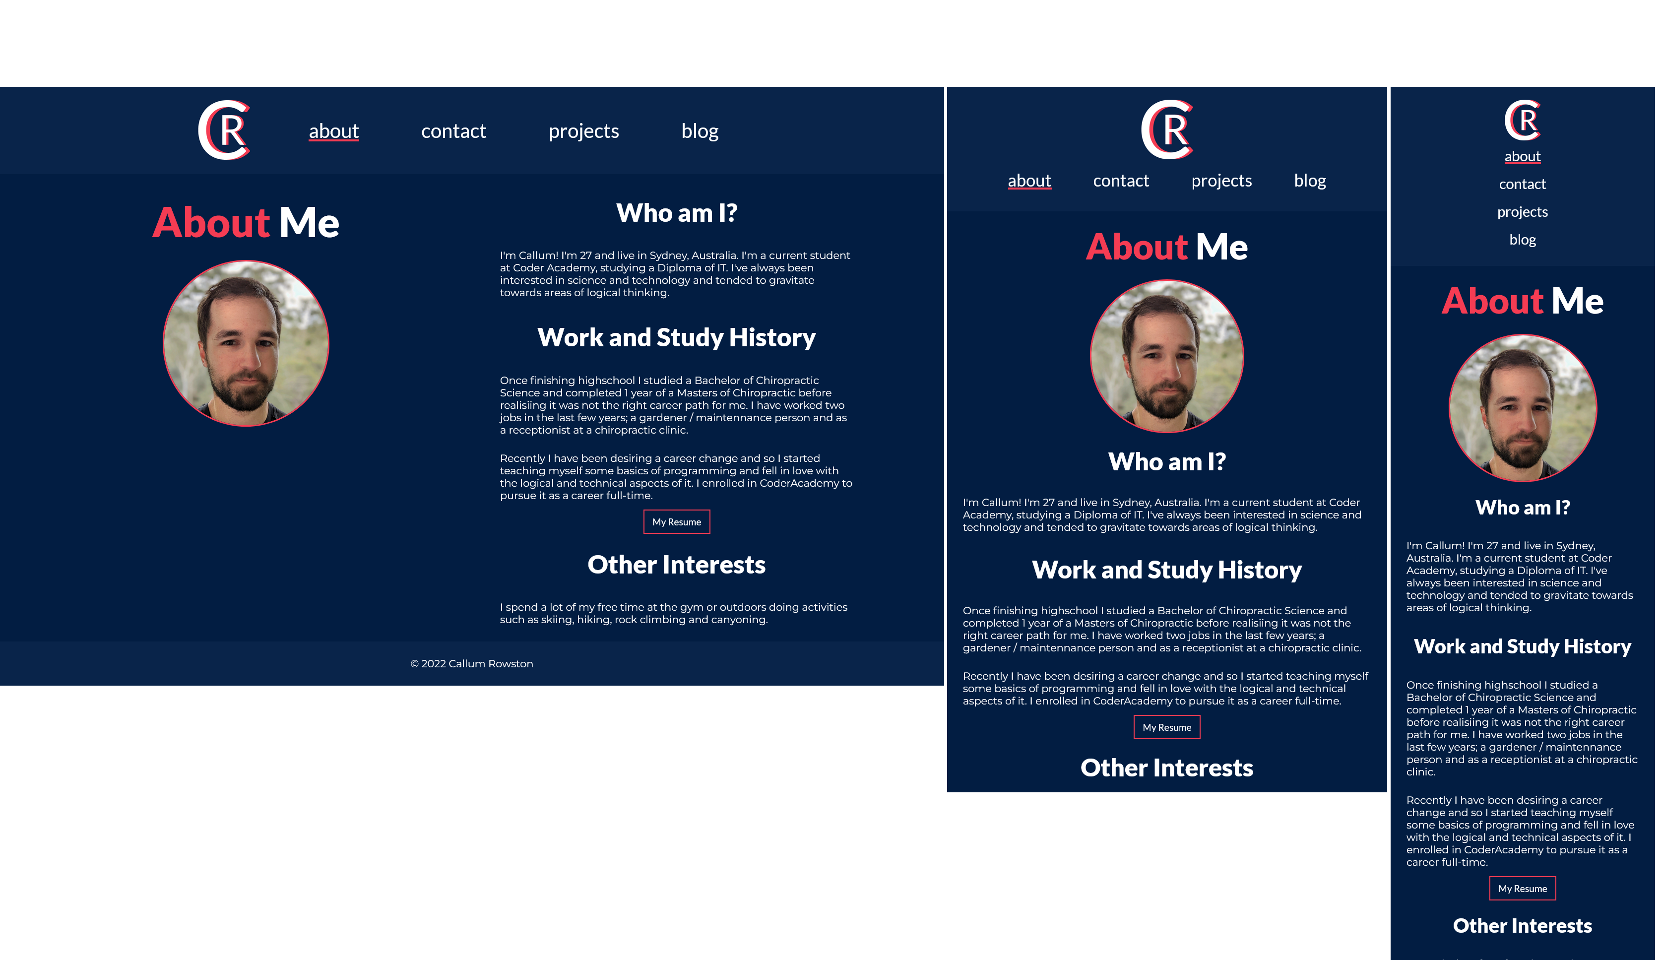
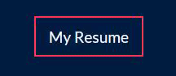
About Page
Notes:
About – Gives the user. Also links to my resume for professional purposes.
Resume button – lights up in accent colour to show its clickable

Slide 8
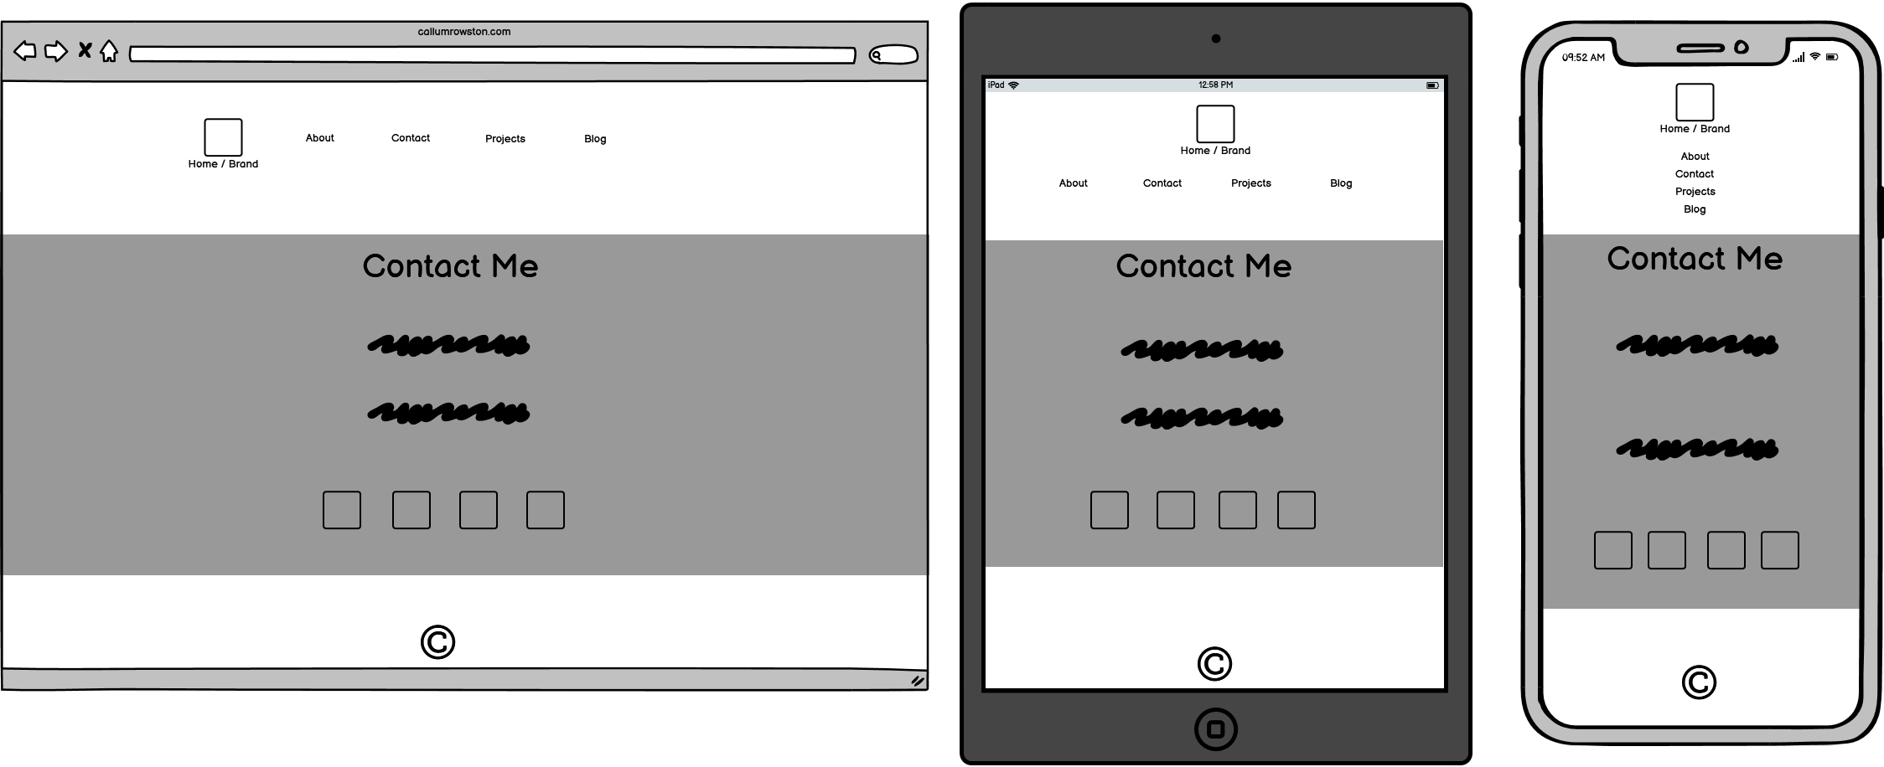
Contact Page - Wireframes
Notes:
Plenty of spacing to fill out the page but also make each individual point of contact stand out on its own
Provides links to my social media accounts again so the user has access to all avenues of contact on one page.

Slide 9
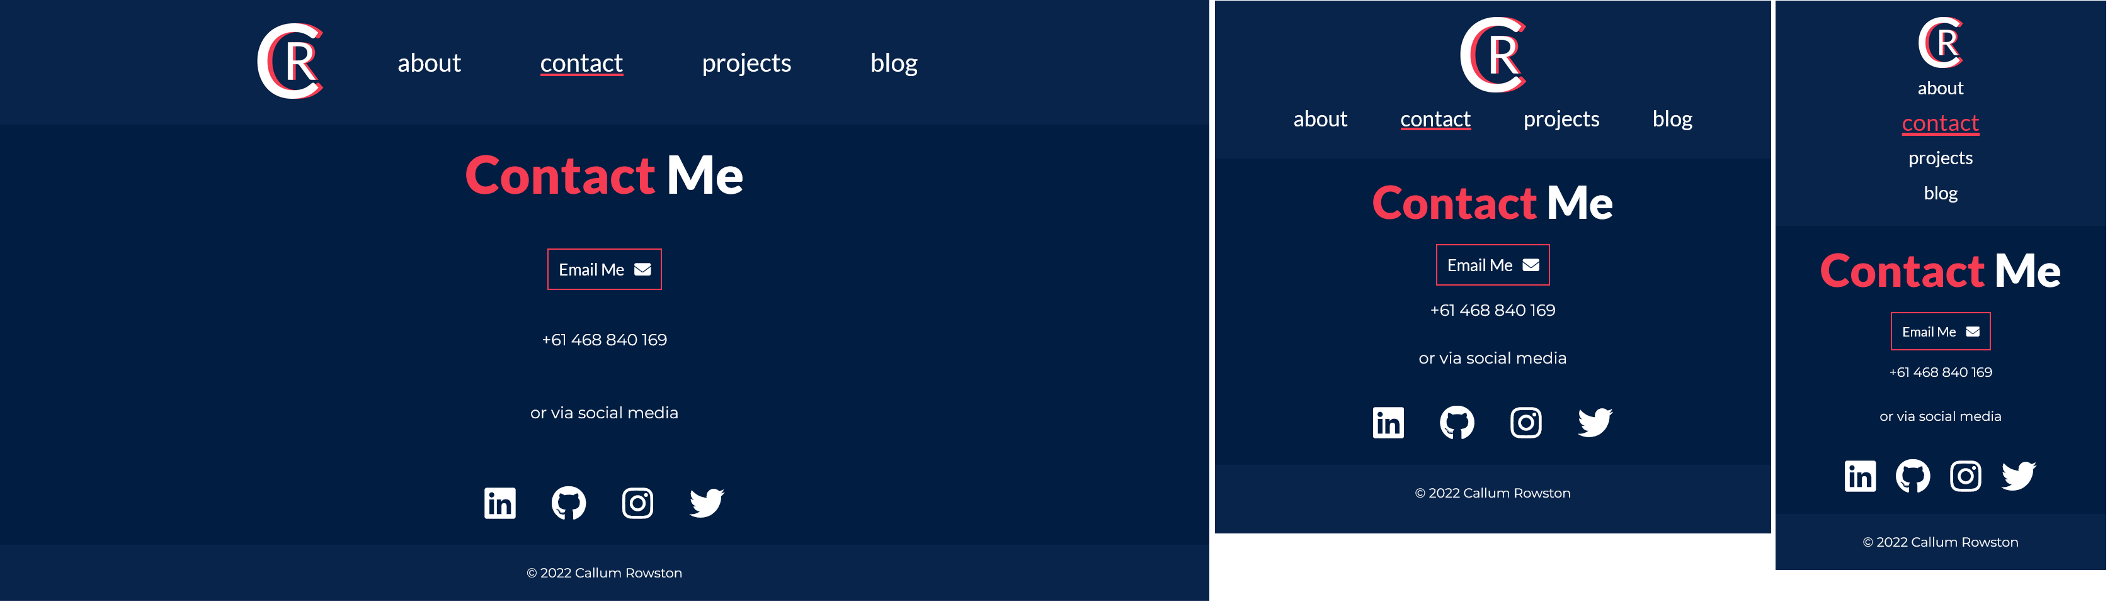
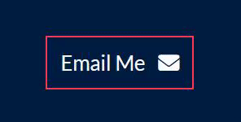
Contact Page
Notes:
Contact – Lays out all my contact details neatly.
Email button that the user can click to quickly open their email application with my email inserted as the recipient.

Slide 10
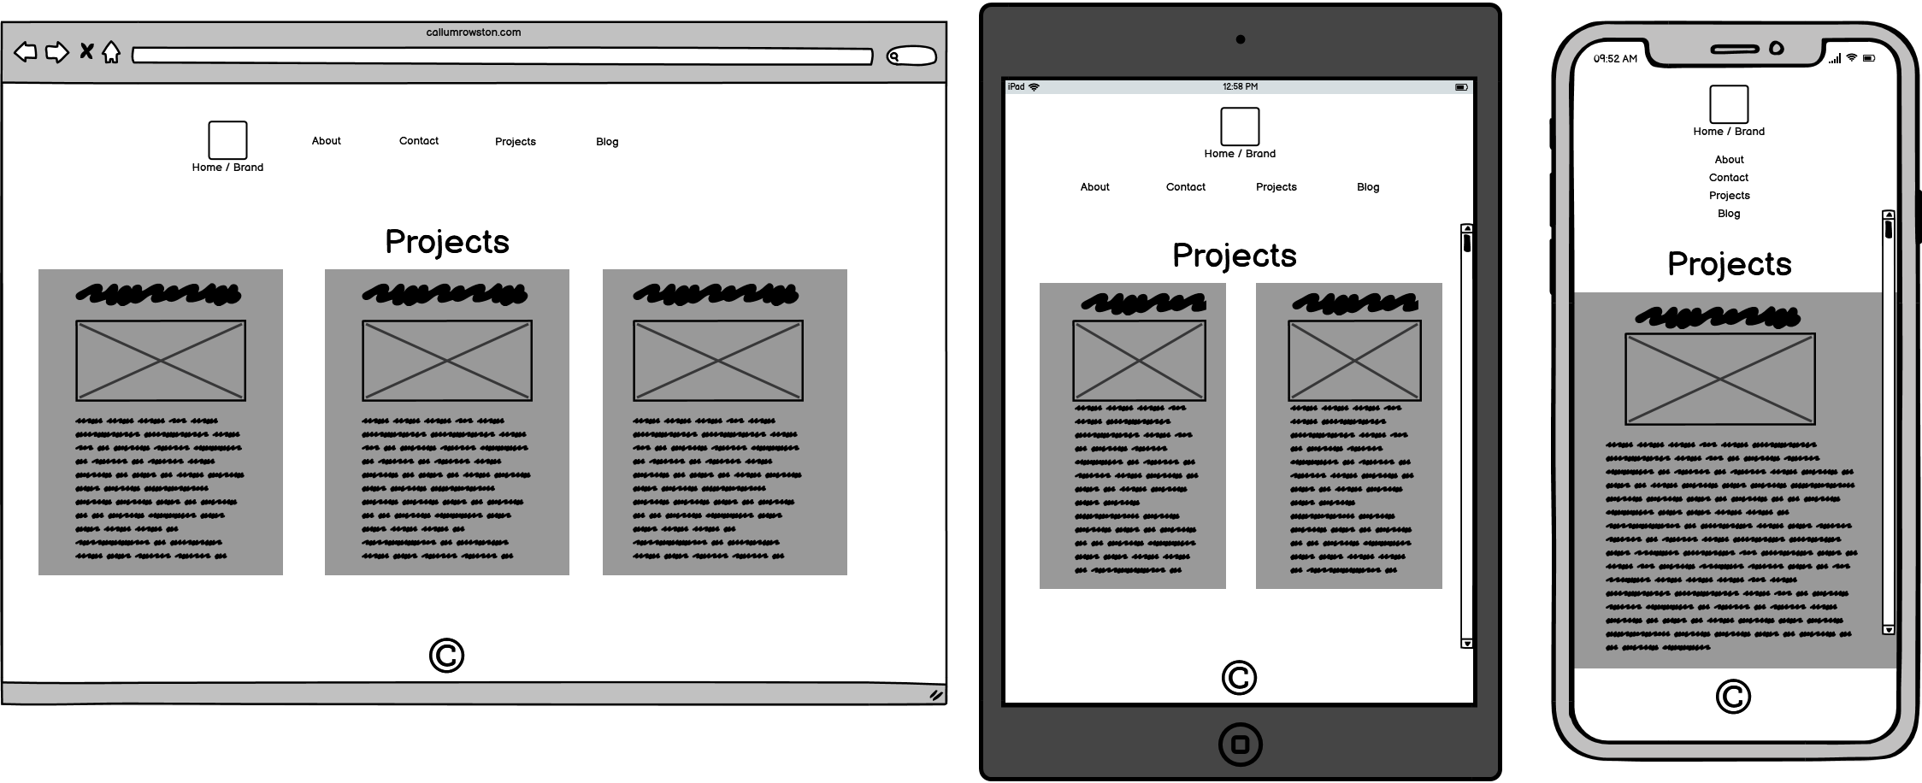
Projects Page - Wireframe
Notes:
Having each project on its own card makes it stand out as its own piece of content. Also makes it logical in how the content adjusts to different screen sizes.

Slide 11
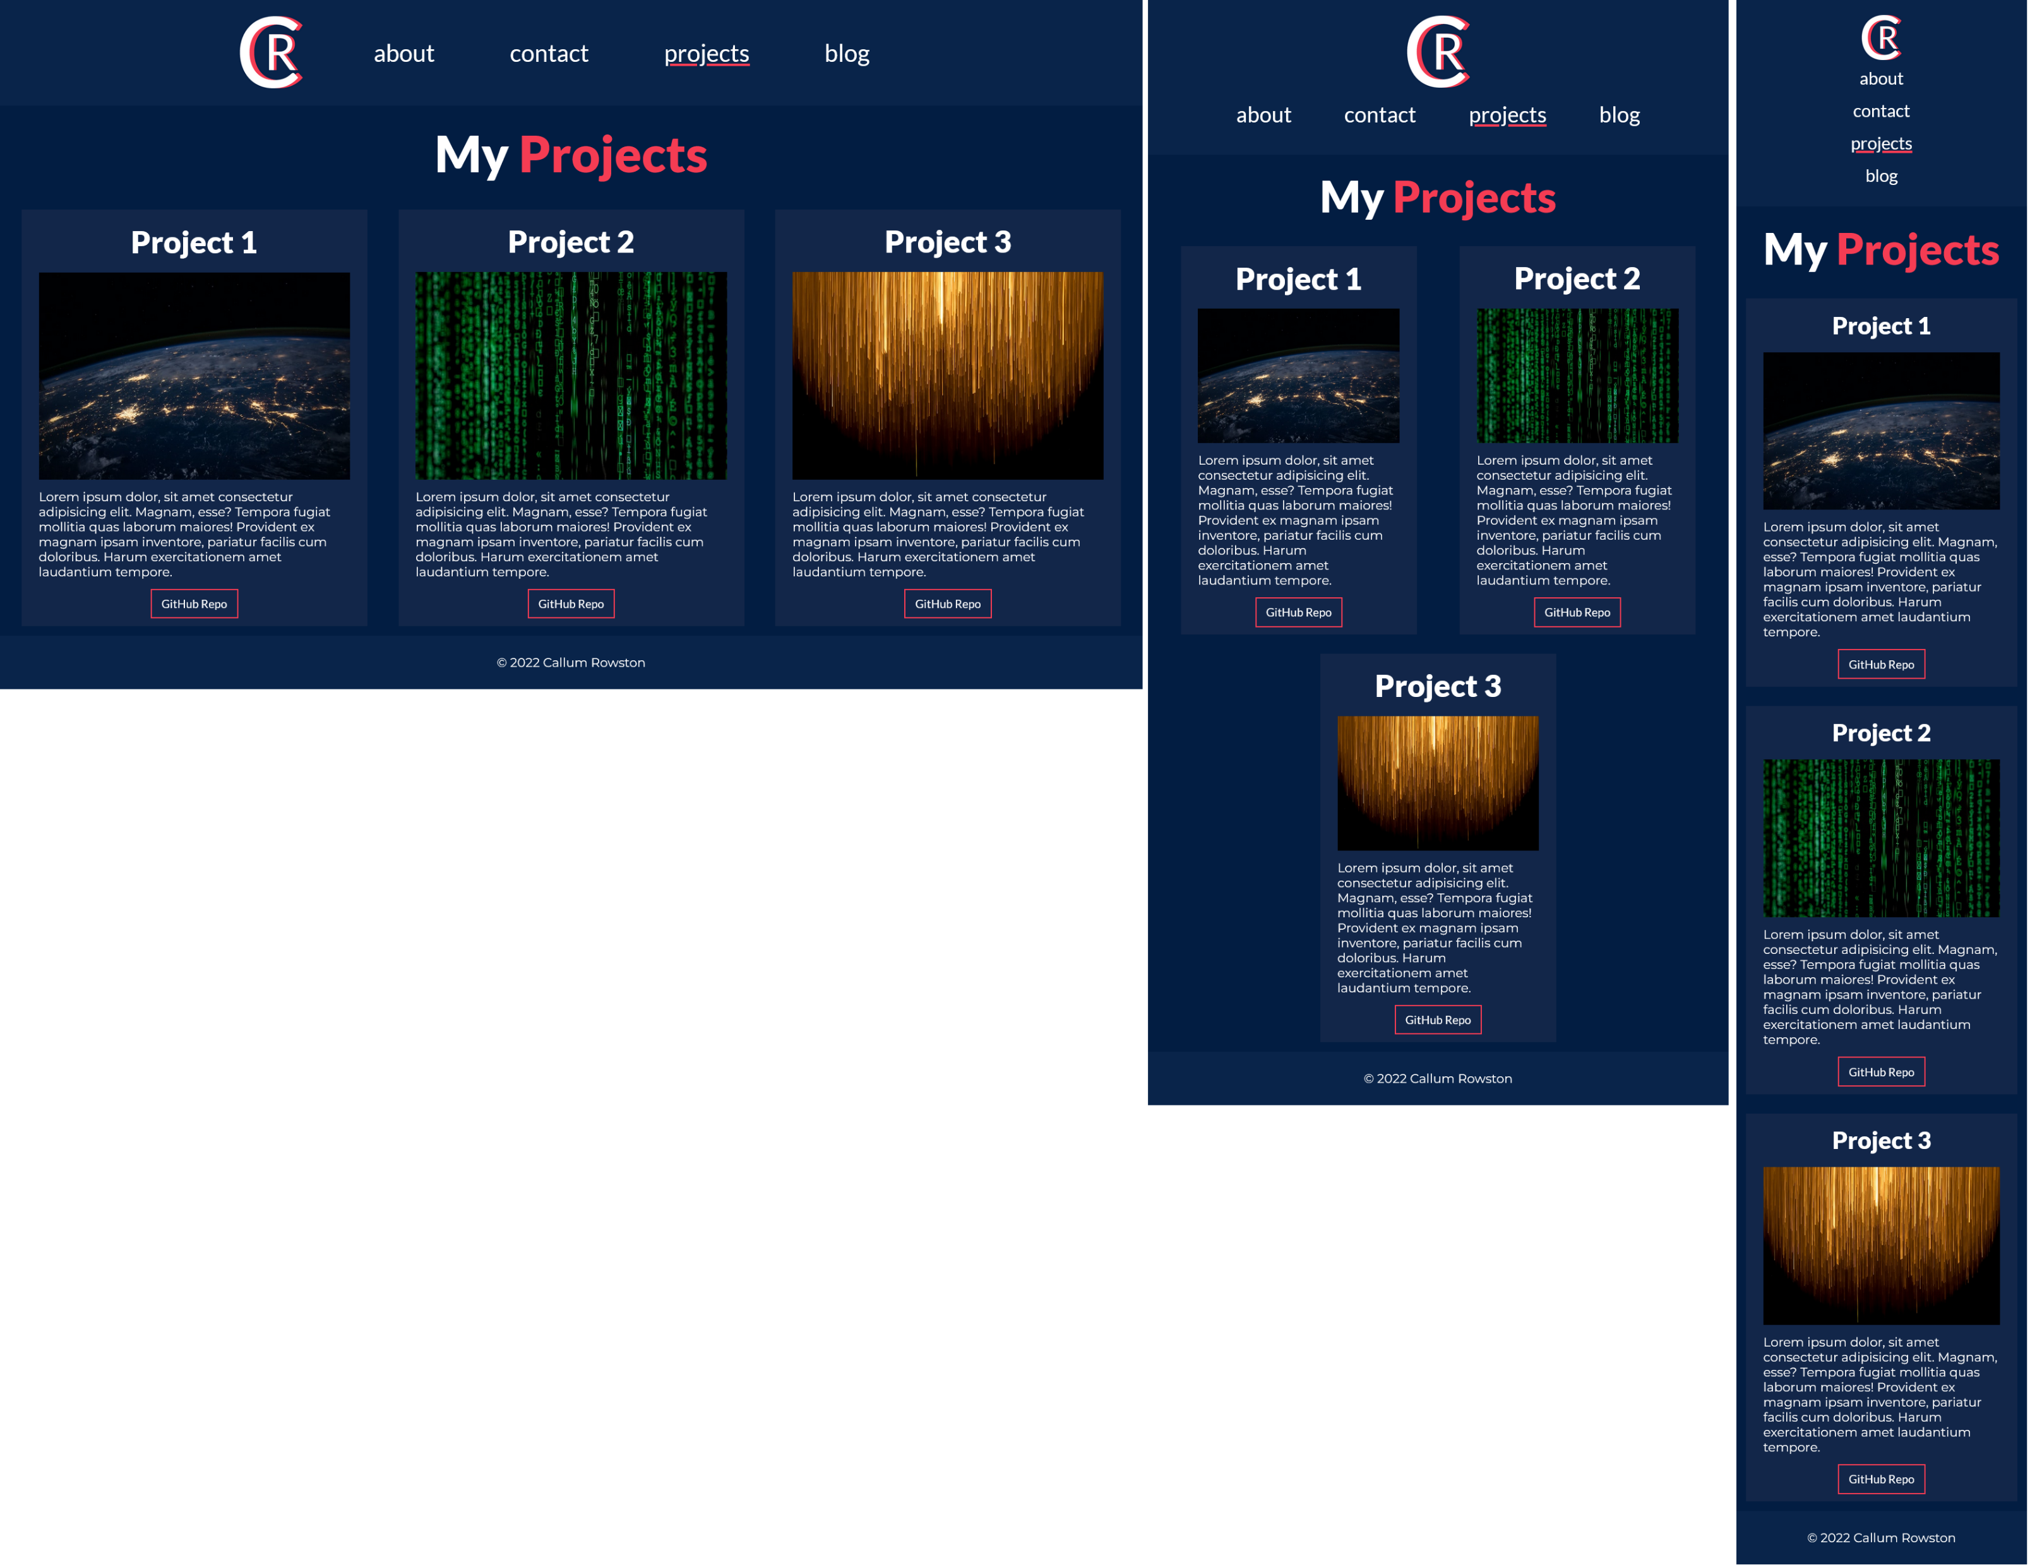
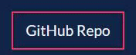
Projects Page
Notes:
Projects – Projects cards will provide information via image and text about software projects I have completed. Since I haven’t actually made any yet they are just placeholders but I’ll be able to easily insert a relevant image and a short description and then if the user wants more information they will be able to click the button at the bottom to go to my corresponding github repository.

Slide 12
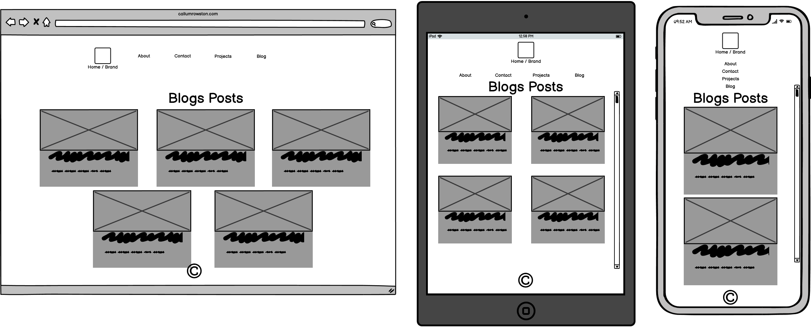
Blog Main Page - Wireframe
Notes:
Similarly to the project cards, having each blog on its own blog card makes it stand out and makes navigation simple.. Also makes it logical in how the content adjusts to different screen sizes.
Blog – Blog Cards to provide the user a glimpse at the blog post. Includes title of the blog post and an image, as well as the date published and number of comments on the blog post and the category of the blog post.

Slide 13
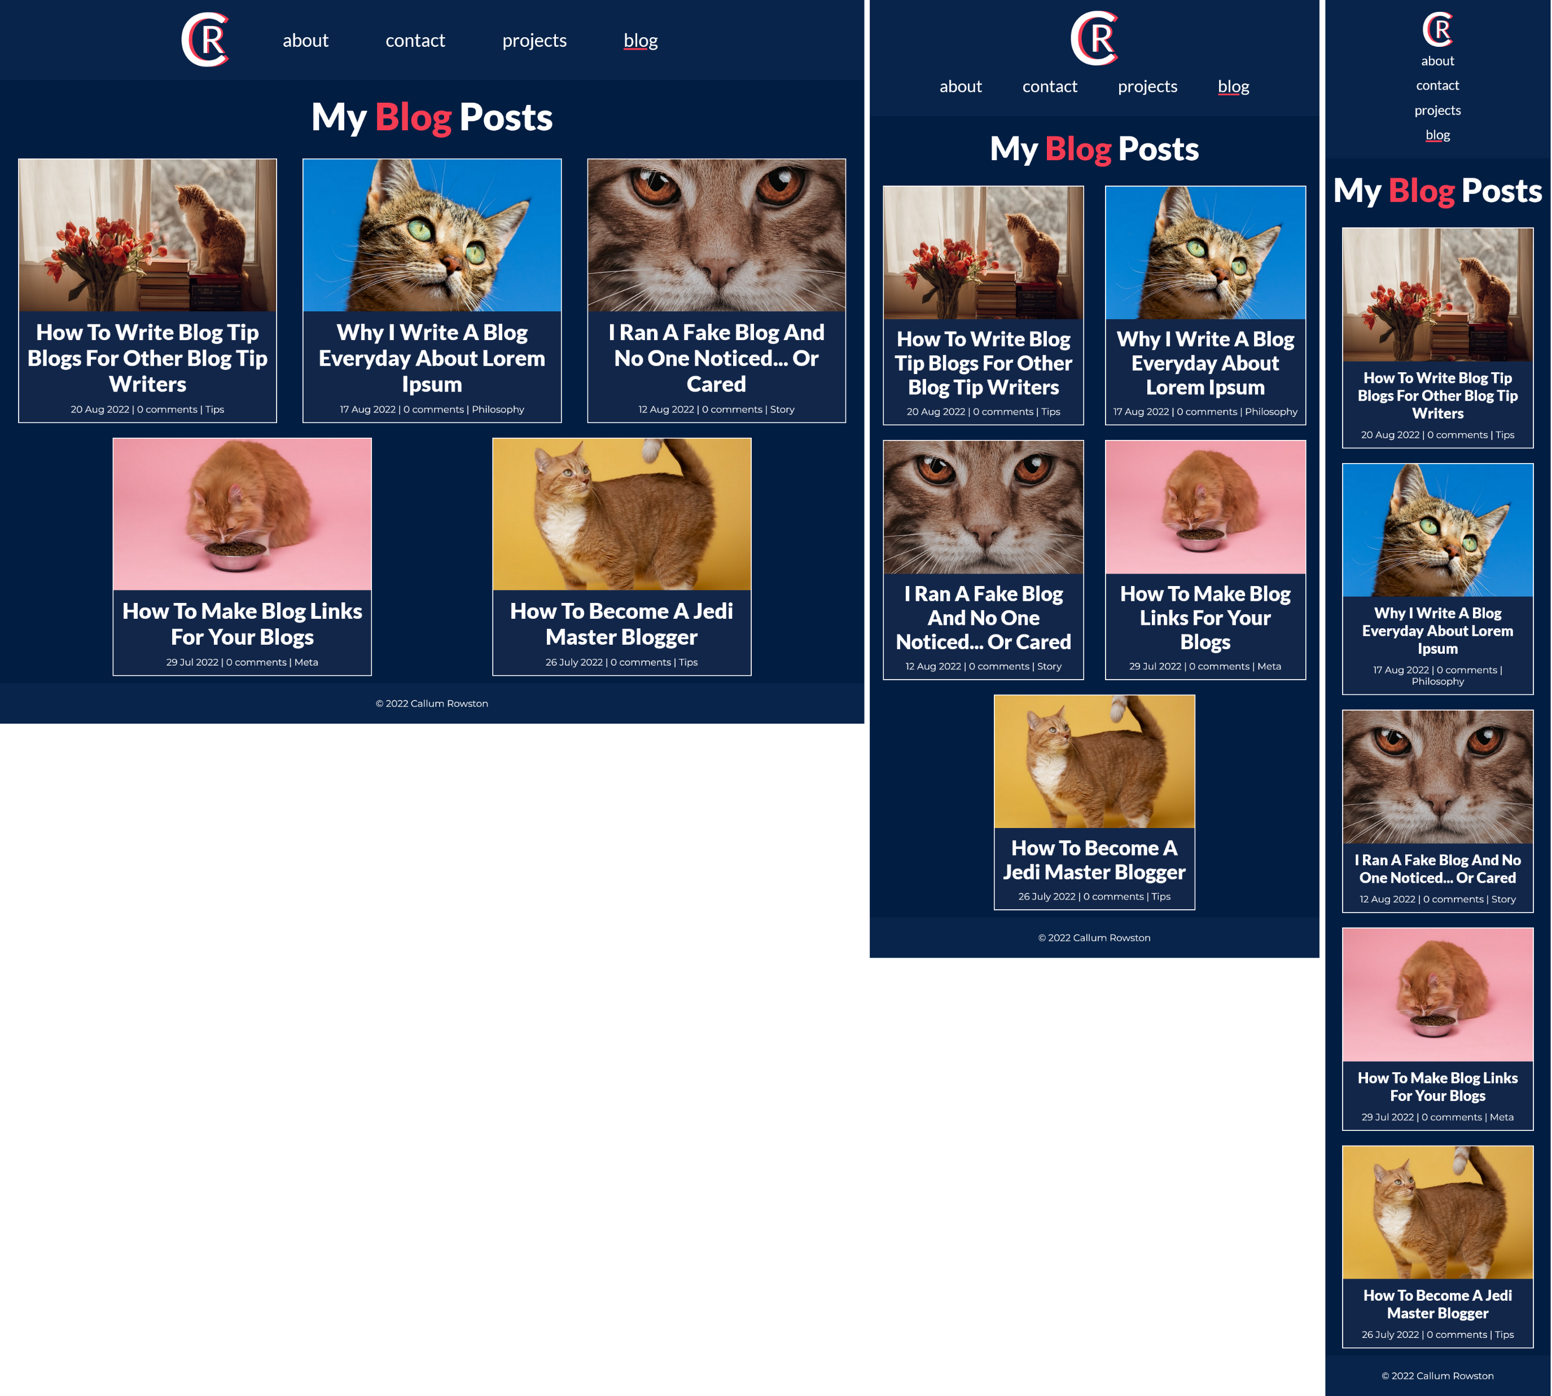
Blog Main Page

Slide 14
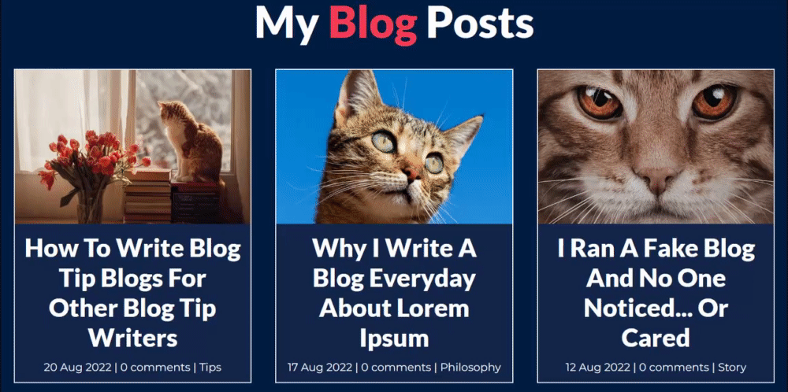
Blog Card Animation
Notes:
Simple yet obvious and engaging animation that uses size and colour change to show the user what they are selecting

Slide 15
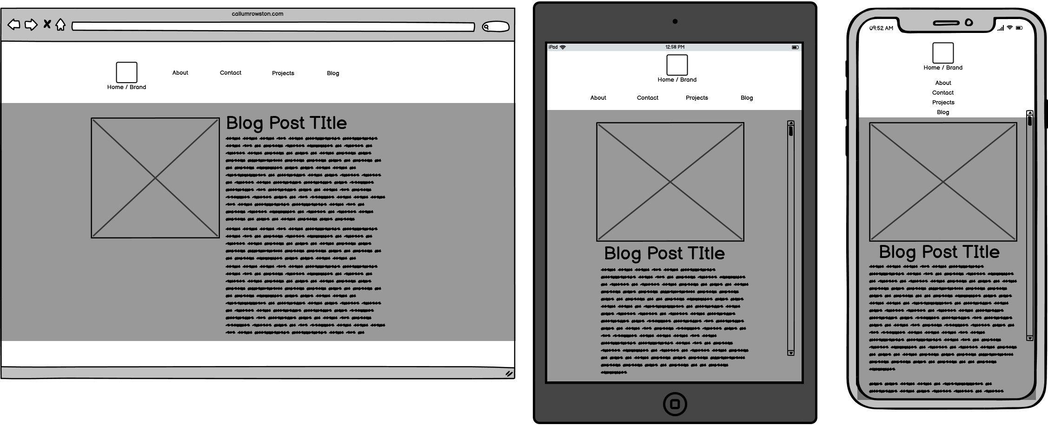
Blog Post Page - Wireframe
Notes:
Simple layout. Image, title, author and the full text of the blog post.
Large margins on desktop so lines of text don’t become really long and make it difficult to start reading the next line

Slide 16
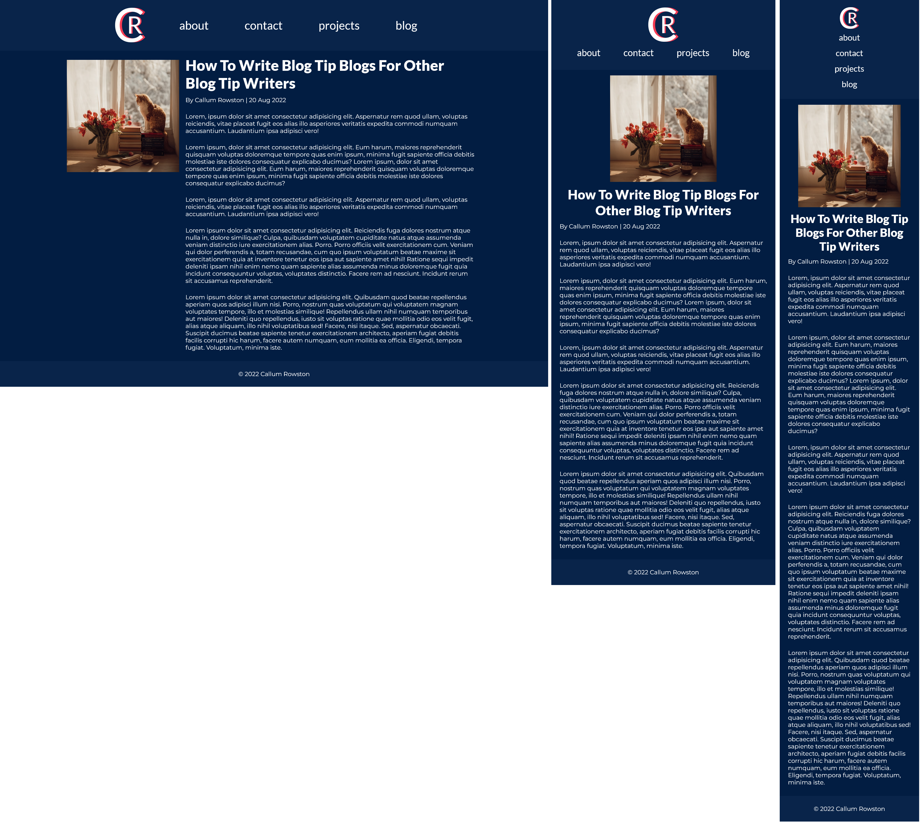
Blog Post Page
Notes:
Author and date.

